Slide 1
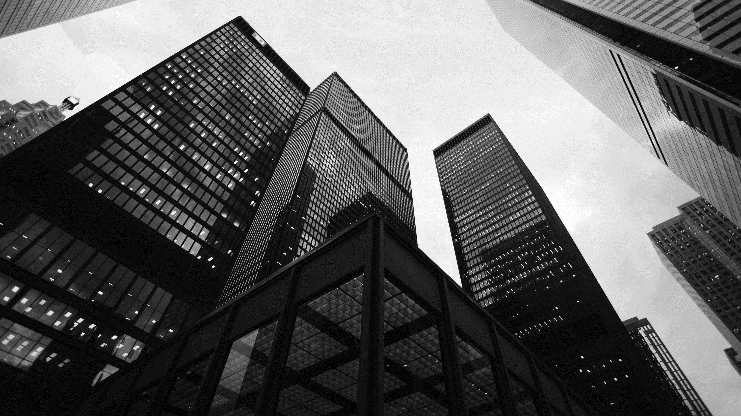
RedXParking
DEMO & PRESENTATION
Notes:
Photo by Sean Pollock on Unsplash

Slide 2
SPRINT 1
Notes:
Photo by Sean Pollock on Unsplash

Slide 3
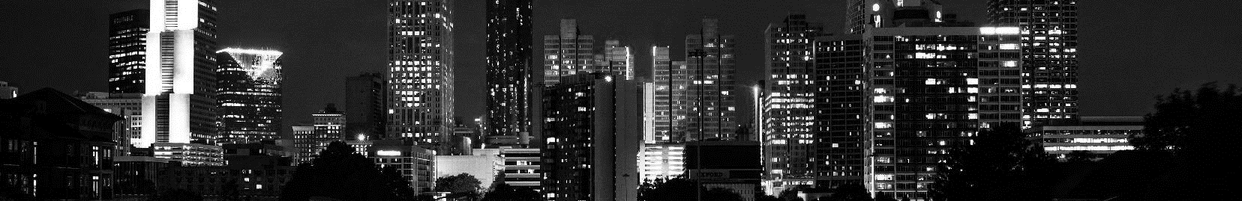
SPRINT 1 - GOALS
Getting cloud API set up and running.
Adding basic functionality to Web navigation app with the help of OpenData from https://data.melbourne.vic.gov.au/Transport-Movement/On-street-Parking-Bay-Sensors
Setting Raspberry Pi to interact with API.
Working on frontend of the website
Hardware design.
Notes:
<a href="https://www.freepik.com/free-photos-vectors/business">Business photo created by rawpixel.com - www.freepik.com</a>

Slide 4
Sense, Think & Act
Notes:
Photo by Sean Pollock on Unsplash

Slide 5
Sense, Think & Act
Sense – Detecting whether there is a vehicle in a parking spot
Data driven solution to address the issue using the publicly available dataset.
For the parking spots that doesn’t have sensors we implement our own sensors.
Think – Whether displaying available or occupied for the bay.
Act – displaying the status of the parking bay
Notes:
<a href="https://www.freepik.com/free-photos-vectors/business">Business photo created by rawpixel.com - www.freepik.com</a>

Slide 6
User Stories - Features
User Story | Features | Points
As a designer I would like to have feedback and user requirements so I can design the system a user friendly manner | Feedback | 1
As a software developer I would like to know the hardware design to create the relevant software. | Hardware design for the relevant software | 3
As a user I could like to get frequent updates about the availability of the parking spots while reaching the spot. | Frequent updates | 4
As a hardware developer I would like to know the sensing requirements of the system to create a robust hardware design. | Sensing requirements | 2
Notes:
<a href="https://www.freepik.com/free-photos-vectors/business">Business photo created by rawpixel.com - www.freepik.com</a>

Slide 7
User Stories – Features
User Story | Feature | Points
As a hardware developer I would like to know the requirements of the software to make the hardware accordingly. | Software Requirements | 3
As the software developer I would like to know the requirements of the user to create the system diagram | User requirements for system diagram design. | 2
As a user I would like to know about available parking venues and availability of parking spots near the venue I want to go. | About available parking venues and availability of parking spots | 5
As the web developer I would like to know the data transferring protocols to create the web API | Data transferring protocols | 1
Notes:
<a href="https://www.freepik.com/free-photos-vectors/business">Business photo created by rawpixel.com - www.freepik.com</a>

Slide 8
Backlog
https://app.gitkraken.com/glo/board/XW4APgtDJAAPHCC6
Notes:
<a href="https://www.freepik.com/free-photos-vectors/business">Business photo created by rawpixel.com - www.freepik.com</a>

Slide 9
Burndown Chart
Notes:
<a href="https://www.freepik.com/free-photos-vectors/business">Business photo created by rawpixel.com - www.freepik.com</a>

Slide 10
PROPOSED
SYSTEM
Notes:
Photo by Sean Pollock on Unsplash

Slide 11
PROPOSED SYSTEM
Following is a diagram of the mechanism of the proposed system.
Start
Data collection via Sensors
Extracting data from sensors by Arduino Uno
A Smart parking System which will display the status and availability of the parking bays in the respective location.
Is the parking bay occupied
Yes
No
Set Status - occupied
Set Status – not occupied
Check the status – occupied / not
Notes:
<a href="https://www.freepik.com/free-photos-vectors/business">Business photo created by rawpixel.com - www.freepik.com</a>

Slide 12
HARDWARE
Notes:
Photo by Sean Pollock on Unsplash

Slide 13
HARDWARE
Arduino platform is used to create the basic protype needed for implementation.
AtMega328p is used as the base microcontroller for the final design.
For the sensors we are using ultrasonic range finding sensors and PIR motion sensors.
Raspberry Pi is used to create nodes to json data logging to the central node (Cloud Service)
Notes:
<a href="https://www.freepik.com/free-photos-vectors/business">Business photo created by rawpixel.com - www.freepik.com</a>

Slide 14
SOFTWARE
Notes:
Photo by Sean Pollock on Unsplash

Slide 15
SOFTWARE
Our server consist of two application layers (data service backend, responsive front end)
Backend is consisted of necessary software to log data to an SQL database and responsive front end UI for all consumer devices
Frontend is consisted of user web app and documentation for the application.
Prototyping of the hardware will be done with Arduino(Pseudo C) language and python will be used in raspberry pi
AtmelStudio will be used along with C language to make a more robust hardware design.
Notes:
<a href="https://www.freepik.com/free-photos-vectors/business">Business photo created by rawpixel.com - www.freepik.com</a>

Slide 16
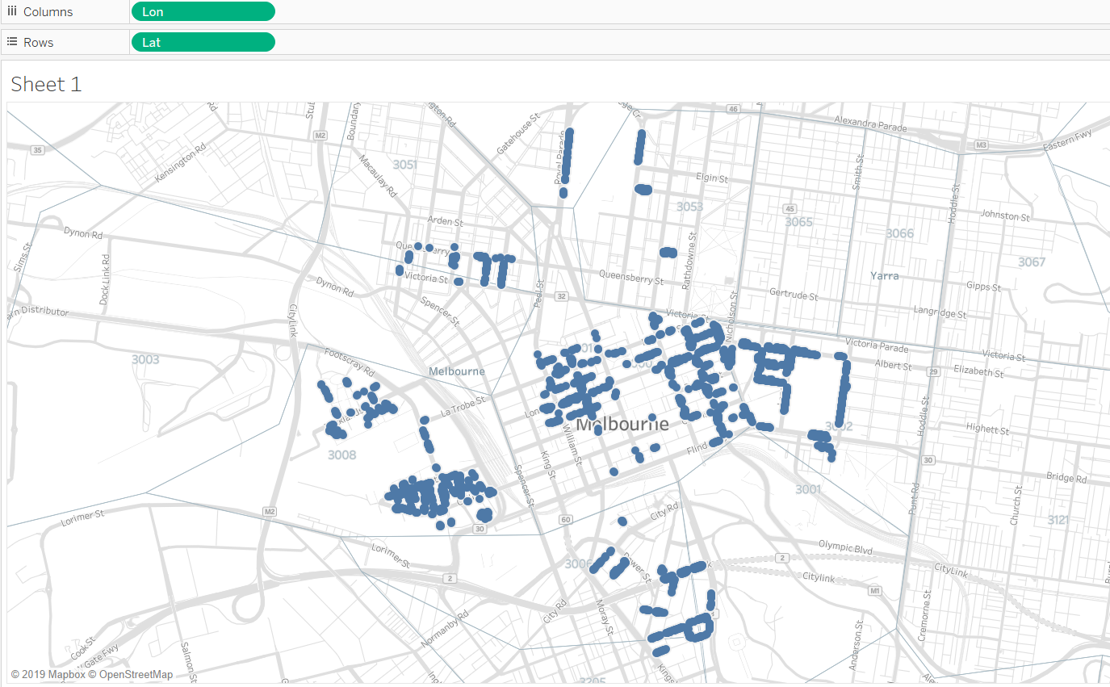
Data
The following diagram is a visualization of the location of the parking bays where some are present as well as some are unoccupied
Sensors in these location will be used to collect data about the parking bay.
Ultra sonic and PIR motion Sensors will be installed for other locations.
The graph represents the parking locations where the sensors are installed to monitor the status. Noted by Melbourne Open Data
Notes:
<a href="https://www.freepik.com/free-photos-vectors/business">Business photo created by rawpixel.com - www.freepik.com</a>

Slide 17
Improvements
Availability and the status of the parking bay will be displayed on web page.
Real time data from the in-ground sensors.
Calibrating with google maps for accurate location for driver.
Notes:
<a href="https://www.freepik.com/free-photos-vectors/business">Business photo created by rawpixel.com - www.freepik.com</a>

